Slide 1
FINANCIAL AID
Rush Henrietta
September 19. 2017

Slide 2
Topics
College Costs
  Sticker Price versus Net Price
What is Financial Aid?
  Sources; Types
How Do I Apply? When Do I Apply
  Free Application Federal Student Aid (FAFSA)
  NYS TAP Application
  Excelsior
  Others – depends on school
Strategies/Tools

Slide 3
THREE TIME POINTS OF PAYING
Before | During | After
Savings 529 Plan Education IRA Investments | Financial Aid Grants Scholarships | Student Loans
Achievement Grades Test Scores Service | Work Student earnings Work-study Internship | Parent Loans
AP/IB/Dual Enrollment | Education Tax Credits Payment Plans | Payment Agreements

Slide 4
How Much Does College Cost?
Cost of Attendance (COA) Includes:
Tuition and fees
Room and board
Books and supplies
Transportation
Miscellaneous personal expenses

Slide 5
Cost of Attendance (COA)
Average Annual Cost Comparison
SUNY Private CC
Tuition and fees: $8,000 $34,000 $5,000
Room and board: 12,500 12,500 ????
Books and supplies: 1,400 1,400 1,400
Transportation: 1,000 1,000 1,500
Personal expenses: 1,500 1,500 1,500
Total Budget: $24,400 $50,400 $9,400

Slide 6
What is Financial Need?
COST OF ATTENDANCE (COA)
Minus
Expected Family Contribution (EFC – comes from FAFSA Result)
Equals = Financial Need

Slide 7
College Cost Net Price
Actual cost AFTER Financial Aid is Applied
EVERY college has a Net Price Calculator on their website for you to estimate your Net Price.
Free to review anytime; no obligation
Private Colleges usually ask more questions on this calculator (for merit aid) – they use more of their own money in financial aid packages.

Slide 8
Sources of Financial Aid
Federal – Pell Grant, SEOG Grant, Teach Grant, Work-Study, Student Loans, Parent Loans
State - New York Grant (TAP) for New York residents attending college in NY State, Excelsior, NY STEM Grant
College you attend – Scholarships, work, loans
Private Sources - Scholarships and loans

Slide 9
Types of Financial Aid
Grants
Scholarships
Loans
Employment Opportunities (work study; internship)

Slide 10
GRANTS
STATE
FEDERAL
TAP – any NY college
  NY Net Taxable Income below $80,800
NY Programs
  Excelsior - SUNY
  STEM – SUNY school – top 10%
PELL Grant
  EFC below 5328
  $0 to $5920 (2017-18)
SEOG Grant
TEACH Grant

Slide 11
Excelsior Scholarship
Effective Fall 2017
Award covers tuition only
How it works:
  Award equals $5,500, minus any amounts received for TAP, Pell or other scholarships
  Remainder of tuition will be covered through a tuition credit paid through SUNY or CUNY

Slide 12
Excelsior Eligibility
Be a resident of New York State
Enroll in a SUNY or CUNY two- or four-year degree program
Take 30 credits per calendar year (including winter and summer terms)
Maintain good academic standing
Plan to live and work in New York following graduation for the length of time you participate in the scholarship program
Household adjusted gross income does not exceed these limits :
  2017/18: $100,000 (based on 2015 tax return)
  2018/19: $110,000 (based on 2016 tax return)
  2019/20: $125,000 (based on 2017 tax return)

Slide 13
Excelsior Application
  Students must complete the FAFSA and TAP applications
  The application includes an agreement regarding post-graduation residency in NYS
  Available and deadline (?)
  Sign up for the HESC alert at www.hesc.ny.gov/excelsior

Slide 14
Scholarships
Your College
  Review Website for merit, need, application
High School
Your College
  Review Website
Civic Groups or Businesses
Places of Employment
Free Internet Searches
  www.fastweb.com
  www.careeronestop.org/toolkit/training/find-scholarships

Slide 15
Federal Direct Student Loan
Subsidized
  4.45% Interest rate (in 2017-18). (Capped at 8.25%)
  Based on need (COA – EFC – other aid = Financial need)
  Federal government pays interest while student in school
  Freshman may borrow up to $3,500
Unsubsidized
  4.45% Interest rate (in 2017-18). (Capped at 8.25%)
  Not based on need
  Student is responsible for interest while in school
  Freshman may borrow up to $5,500 minus any subsidized loan money (ideally - $3,500 subsidized and $2,000 unsubsidized)
Repayment begins 6 months after graduation

Slide 16
Parent Loan for Undergraduate Students (PLUS)
  Loan in parent name
  Credit Check – No Adverse Credit
  7% interest rate (2017-18) (Capped at 10.5%)
  Interest accrues at disbursement
  Payments right away
  Limits
    Up to COA minus other aid.

Slide 17
Work Opportunities
Federal Work Study Program (FWS)
  Need Based
  Limited hours
  Usually minimum wage
  Helps with personal expenses
  Each college has own process; jobs usually on campus or in community service.

Slide 18
How to Apply for Aid
Request an FSA ID for the student and parent
Collect information
Complete FAFSA online: www.fafsa.gov
Complete TAP online
Complete Excelsior Application
Watch for Student Aid Report (SAR) & communicate with the financial aid office

Slide 19
How To Apply
1. Request a Federal Student Aid (FSA) ID: fsaid.ed.gov
  Acts as signature for the FAFSA and any Federal Student Loans.
  Is comprised of a username and password
  For both the student and at least one parent
  Username and password and e-mail used have to be unique for student and different than parent
  Acts as signature for the FAFSA and any Federal Student Loans
  The security of your FSA ID is important
  www.fafsa.gov
    Sign FAFSA electronically
    Used by students and parents throughout aid process
    Only the owner should create an FSA ID

Slide 20
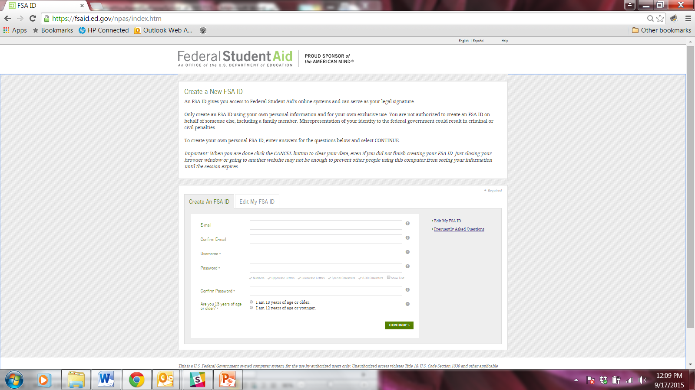
1. Federal Student Aid ID

Slide 21
2. Collect Information
Student and parents’ SSN and DOB
Parents’ marital status
FSA ID for student and parent
W-2s for student and parents
Records of untaxed income for student and parents
Bank accounts, stock, real estate and business record for
student and parents
Student’s driver’s license number
Student’s alien registration number (non-U.S citizens)

Slide 22
How To Apply
3. Complete FAFSA online: www.fafsa.ed.gov.
    For 2018-19, after October 1, 2017.
  Must re-apply each academic year.
  FAFSA asks questions on student and parent income; assets; family size; number in college
  Determines EFC to determine Financial Need

Slide 23
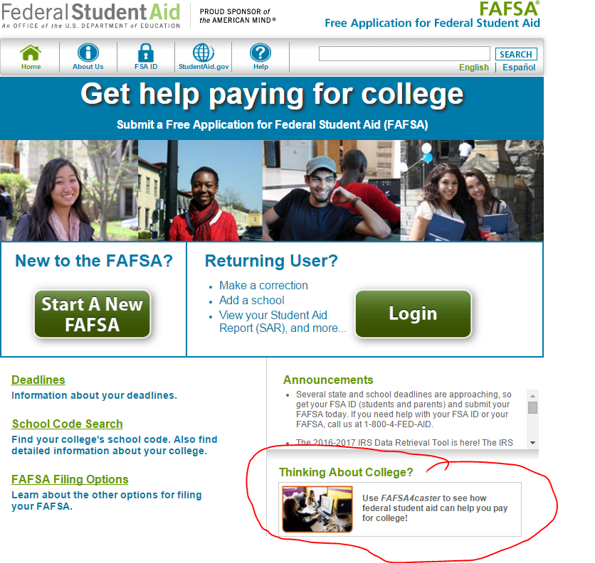
3. Complete FAFSA www.fafsa.ed.gov

Slide 24
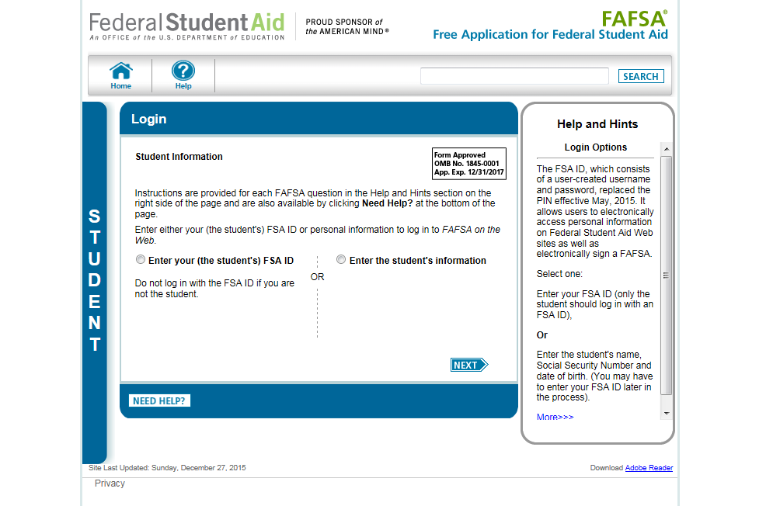

Slide 25
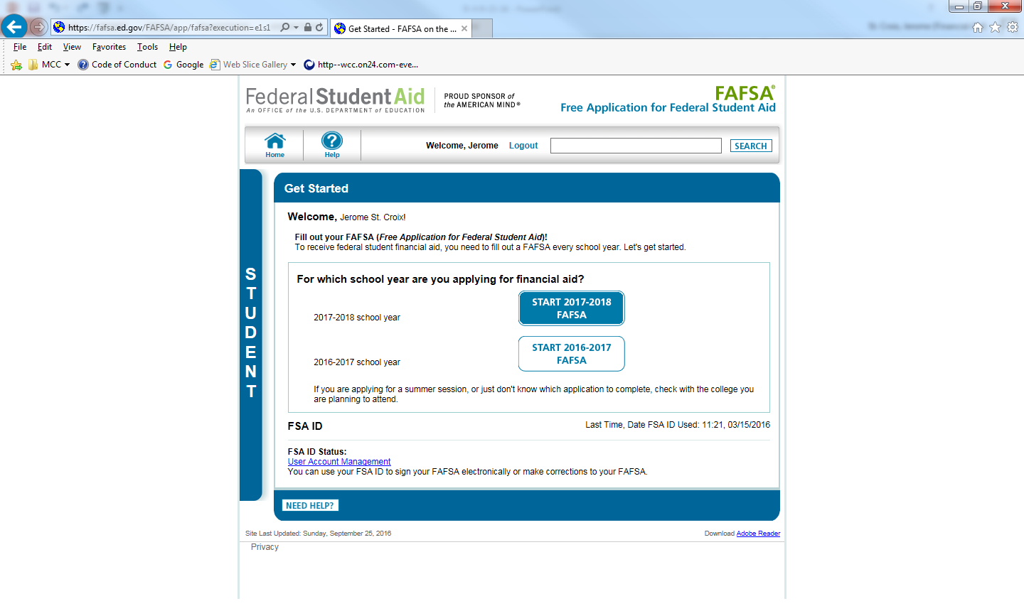

Slide 26
Seven Steps for Filing the FAFSA
Step One: Student Demographics
  Name, social security number, birth date
  Provide an email address
  Indicate gender
  Males have the opportunity to enroll in
  Selective Service
  For more information go to: www.sss.gov
Step Two: School Selection
  Enter FAFSA codes – up to 10 colleges
  Indicate housing status while in college

Slide 27
Seven Steps for Filing the FAFSA
Step Three: Dependency Status
  Generally Dependent if under age 24
  Independent if:
    Married
    A graduate student
    Serving in the U.S. military or a veteran
    Supporting children or other dependents
    Has a court appointed legal guardian
    Has been determined homeless or at risk of
    being homeless
Step Four: Parent Demographics
  Name, social security numbers, birth dates
  Marital status
    If Separation or Divorce–current family unit (parent student lives with the most)
Step Five: Financial Information
  Use 2016 tax returns for 2018-19
  IRS Data Retrieval

Slide 28
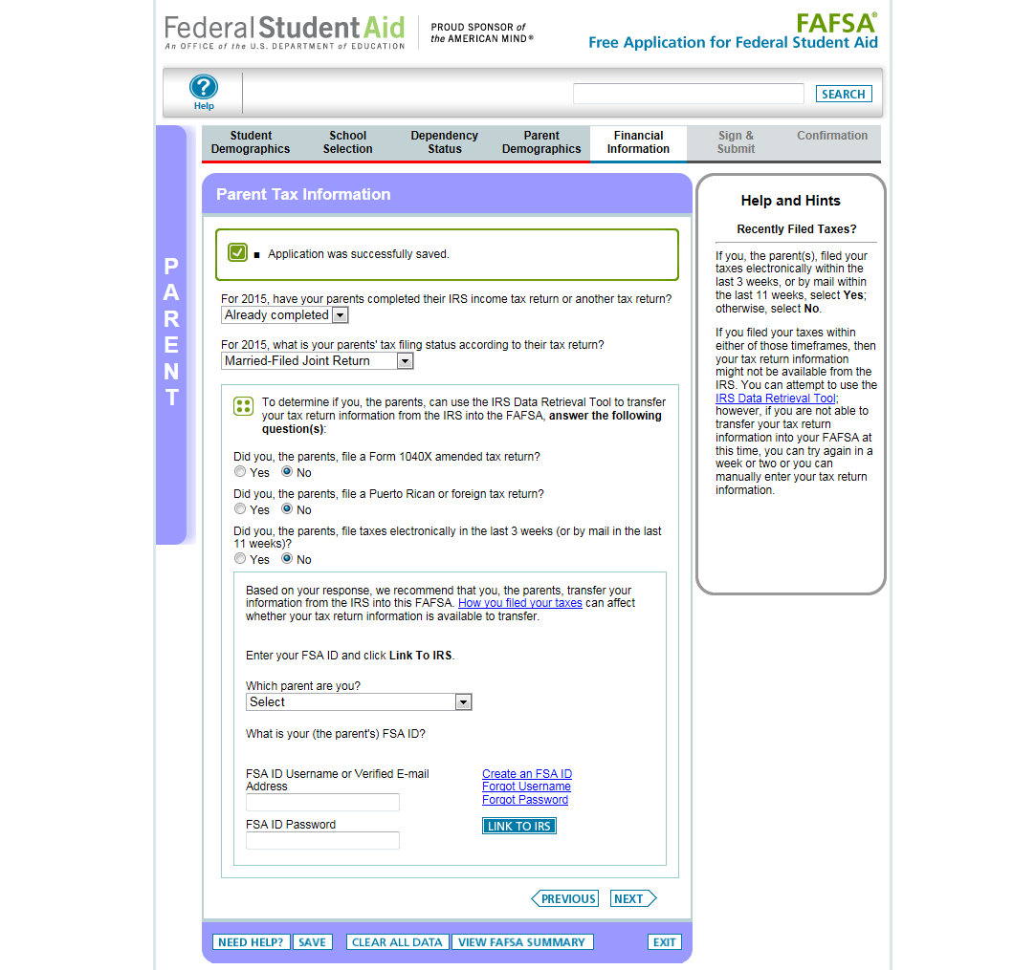

Slide 29
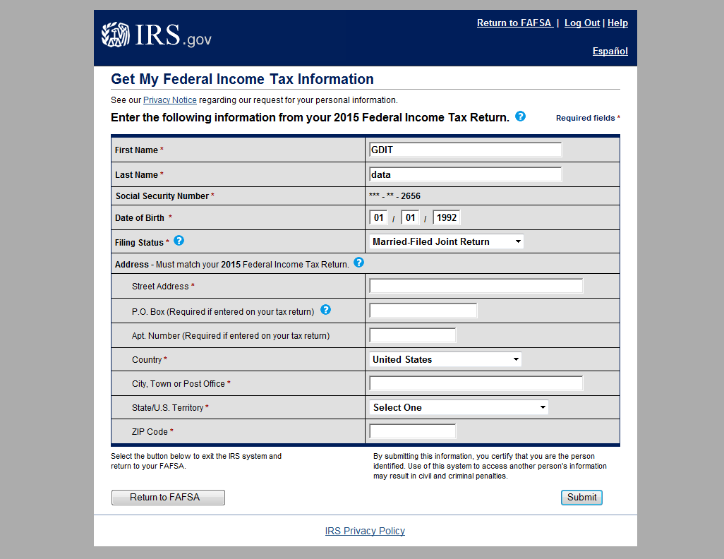
These fields are pre-filled based on FAFSA responses

Slide 30
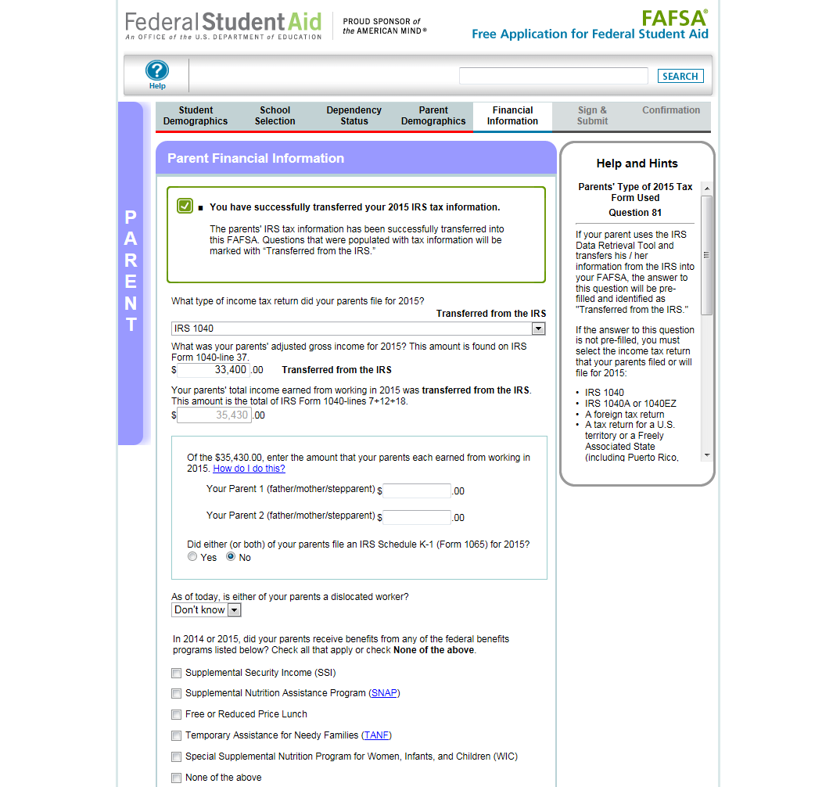

Slide 31
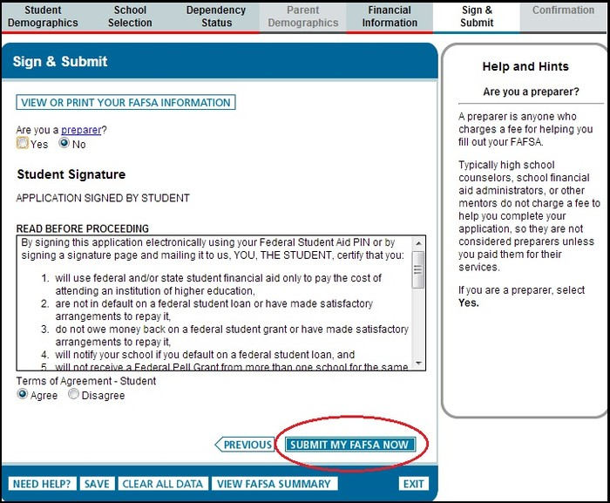
Seven Steps for Filing the FAFSA
Step Six: Sign and Submit using the FSA ID
  Sign electronically

Slide 32
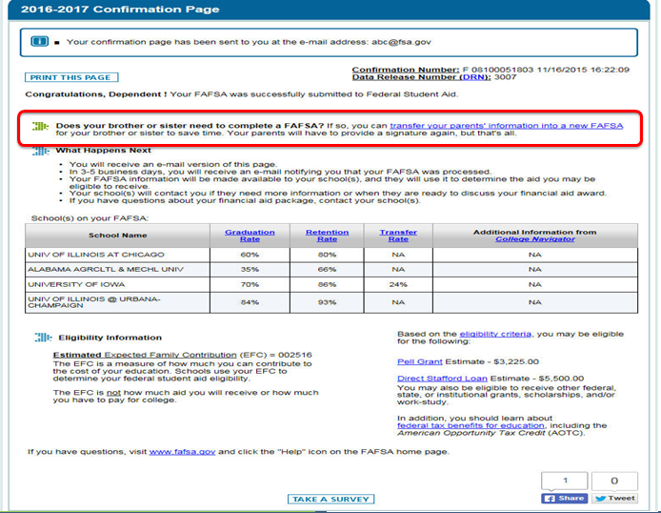
Seven Steps for FAFSA
Step Seven: Confirmation

Slide 33
How To Apply
4. Complete TAP Online
https://www.tap.hesc.ny.gov/totw/
  After completing FAFSA online, from the confirmation page, link to the TAP-on-the-Web. (look for NY Residents)
  Establish student TAP PIN.
  Must re-apply each academic year.

Slide 34
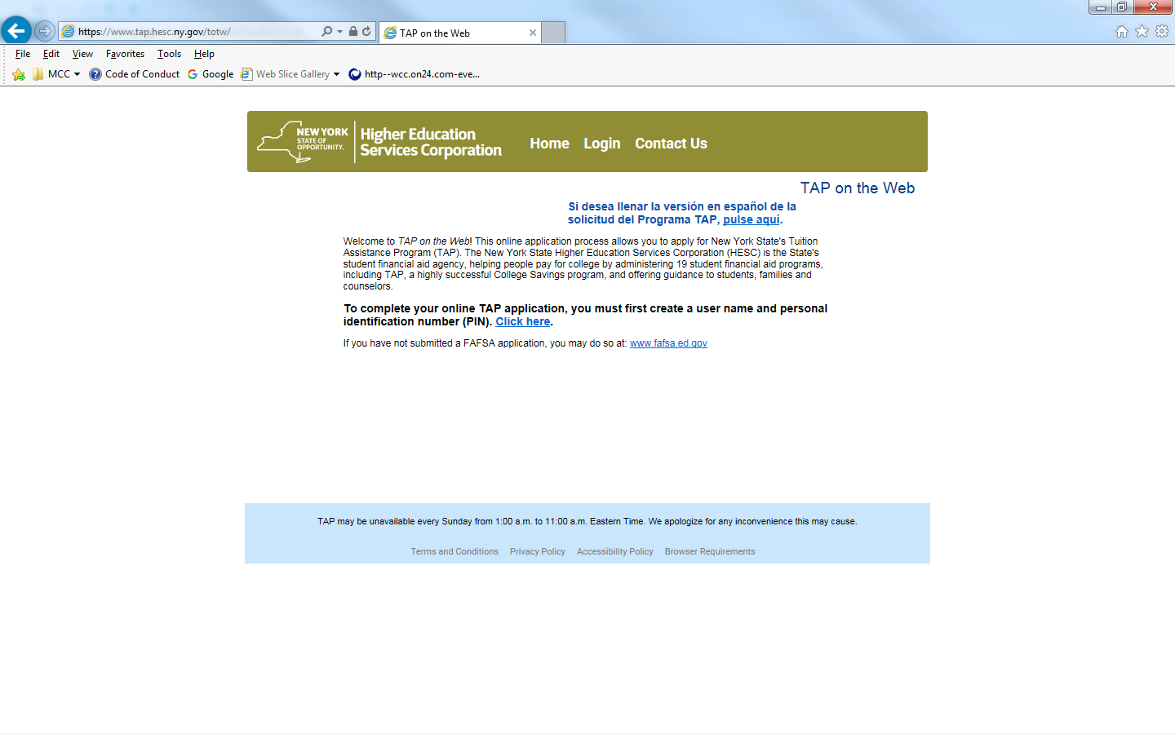

Slide 35
5. Apply for Excelsior
  To be notified when the application becomes available:
  Sign up for the HESC alert at www.hesc.ny.gov/excelsior

Slide 36
6. Watch for SAR & Communicate with Financial Aid Office
  SAR will be available in 3-5 days
  EFC is printed on upper right corner
  Make sure all information is correct
  Corrections-on-the-Web at www.fafsa.ed.gov

Slide 37
When To Apply for
2018-19
FSA ID – Now or Near Future
Scholarship Searches – Now/Ongoing
FAFSA – Anytime after October 1, 2017; Before school deadline.
  Check school websites
TAP – After the FAFSA.
Excelsior – when available
Other Forms??

Slide 38
Other Forms
Check with College:
  CSS Profile – limited number of highly competitive school might use this additional form
    http://css.collegeboard.org/
    After October 1, 2017 for the 2018-19 year
  College might require scholarship application
  Application for other program:
    EOP at Public College or HEOP at Private College – NY State Colleges
      Provides access and resources for students who otherwise might not meet qualifications for the college

Slide 39
Delays in Processing
FSA ID Set Up
Errors on the FAFSA
  Misspelled names or incorrect date of birth or social security numbers.
Citizenship
Selective Service Registration – www.sss.gov
  Males 18-25 can register right on the FAFSA even if 17 when you file FAFSA
Missing signatures

Slide 40
What Happens After I Apply
Can make corrections and changes after filing through the same website. (www.fafsa.ed.gov)
Student notified when FAFSA is processed.
  Sent via e-mail; parent gets e-mail as well
  Student Aid Report (SAR); Determines Estimated Family Contribution (EFC)
Schools receive your data from FAFSA
  May ask for follow up information.
  determine your awards.
  Federal and state grants – set by your applications.
  School based aid and loans (up to loan limit) – based on the schools financial aid packaging policies.

Slide 41
What Happens After I Apply
TAP Award notifications are sent by the Higher Education Services Corporation (HESC).
  Official TAP award notifications are sent out after NYS budget is passed.
  Schools will estimate TAP awards on their award letters.
If you have done all required steps, award letters come out sometime in late winter.

Slide 42
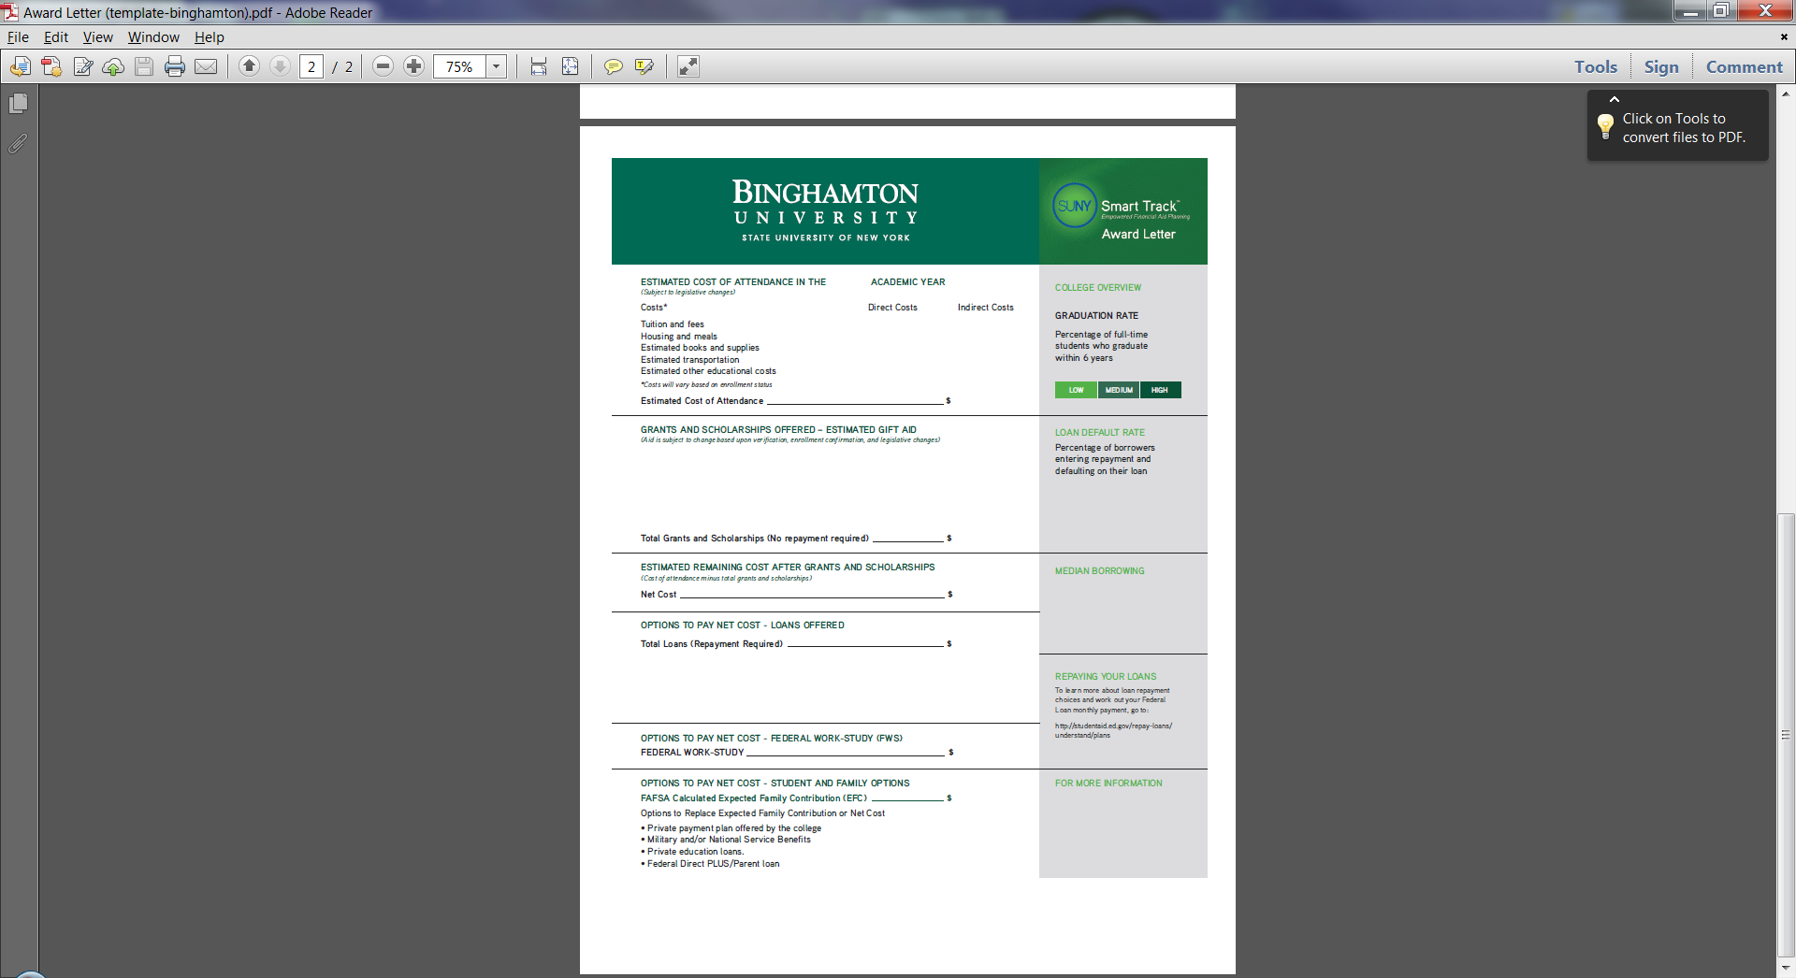

Slide 43
Strategies - Preparation
Keep Organized – be ready to follow up
  System to remember FSA ID; folder for documents; etc…
Meet Deadlines!
Parent/Student Communication
  E-mail checking
Compare – Make Charts?
  Required forms and dates for each school

Slide 44
Strategies - Financing
Payment Plan as opposed to Alternative Financing or Parent Loan.
Savings – 529 plans
Appeals based on unusual circumstances or changes in situation AFTER FAFSA is filed.
  Is 2016 or 2017 income going to be lower than 2015?
Limit Borrowing; compare net costs
Reduce costs – books and supplies; complete on time; set budgets

Slide 45
Questions
Jerome St. Croix
Director, Financial Aid
Monroe Community College
jstcroix@monroecc.edu
(585) 292-2278

